Slide 1
Uninformed Search
Chapter 3.1 – 3.4

Slide 2
Models To Be Studied in CS 540
State-based Models
Model task as a graph of all possible states
Called a “state-space graph”
A state captures all the relevant information about the past in order to act (optimally) in the future
Actions correspond to transitions from one state to another
Solutions are defined as a sequence of steps/actions (i.e., a path in the graph)

Slide 3
Building Goal-Based Agents
What are the key questions that need to be addressed?
What goal does the agent need to achieve?
What knowledge does the agent need?
What actions does the agent need to do?
Notes:
CLICK EACH

Slide 4
Many AI (and non-AI) Tasks can be Formulated as Search Problems
Goal is to find a sequence of actions
Puzzles
Games
Navigation
Assignment
Motion planning
Scheduling
Routing

Slide 5
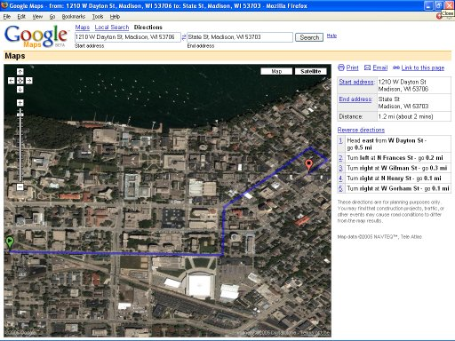
Search Example: Route Finding
Actions: go straight, turn left, turn right
Goal: shortest? fastest? most scenic?

Slide 6






Search Example: River Crossing Problem
Goal: All on right side of river
Rules:
Farmer must row the boat
Only room for one other
Without the farmer present:
Dog bites sheep
Sheep eats cabbage
Actions: F>, F<, FC>, FC<, FD>, FD<, FS>, FS<

Slide 7
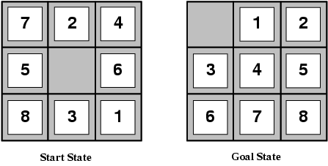
Search Example: 8-Puzzle
Actions: move tiles (e.g., Move2Down)
Goal: reach a certain configuration

Slide 8

Search Example: Water Jugs Problem
Given 4-liter and 3-liter pitchers, how do you get exactly 2 liters into the 4-liter pitcher?
4
3

Slide 9
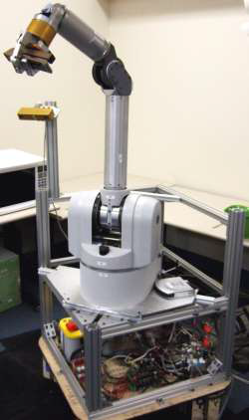
Search Example: Robot Motion Planning
Actions: translate and rotate joints
Goal: fastest? most energy efficient? safest?

Slide 10
Search Example: Natural Language Translation
Italian → English:
la casa blu → the blue house
Actions: translate single words (e.g., la → the)
Goal: fluent English? preserves meaning?
Notes:
In machine translation, the goal is to output a sentence that's the translation of the given input sentence.
The output sentence can be built out of actions, each of which involves translating a single word or a few
words.

Slide 11
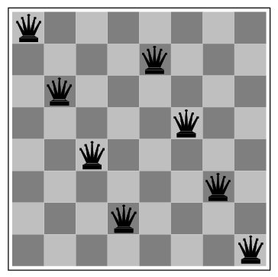
Search Example: 8-Queens

Slide 12
Search Example: Remove 5 Sticks Problem
Remove exactly 5 of the 17 sticks so the resulting figure forms exactly 3 squares

Slide 13
Basic Search Task Assumptions (usually, though not games)
Fully observable
Deterministic
Static
Discrete
Single agent
Solution is a sequence of actions

Slide 14
What Knowledge does the Agent Need?
The information needs to be
sufficient to describe all relevant aspects for reaching the goal
adequate to describe the world state / situation
Fully observable assumption, also known as the closed world assumption, means
All necessary information about a problem domain is accessible so that each state is a complete description of the world; there is no missing information at any point in time
Notes:
CLICK EACH SUB

Slide 15
How should the Environment be Represented?
Knowledge representation problem:
What information from the sensors is relevant?
How to represent domain knowledge?
Determining what to represent is difficult and is usually left to the system designer to specify
Problem State = representation of all necessary information about the environment
State Space (aka Problem Space) = all possible valid configurations of the environment
Notes:
CLICK EACH

Slide 16
What Goal does the Agent want to Achieve?
How do you describe the goal?
as a task to be accomplished
as a state to be reached
as a set of properties to be satisfied
How do you know when the goal is reached?
with a goal test that defines what it means to have achieved/satisfied the goal
or, with a set of goal states
Determining the goal is usually left to the system designer or user to specify
Notes:
CLICK EACH SUB

Slide 17
What Actions does the Agent Need?
Discrete and Deterministic task assumptions imply
Given:
an action (aka operator or move)
a description of the current state of the world
Action completely specifies:
if that action can be applied (i.e., legal)
what the exact state of the world will be after the action is performed in the current state (no "history" information needed to compute the successor state)
Notes:
CLICK EACH

Slide 18
What Actions does the Agent Need?
A finite set of actions/operators needs to be
decomposed into atomic steps that are discrete and indivisible, and therefore can be treated as instantaneous
sufficient to describe all necessary changes
The number of actions needed depends on how the world states are represented
Notes:
CLICK EACH SUB
Discrete: e.g., if "Kelly is in class" and then performs the action "go home," then in the next situation Kelly is "at home." There is no representation of a point in time where Kelly is neither in class nor at home (i.e., in the state of "going home").
Quantity: e.g., in the 8-puzzle, we could specify 4 possible moves for each of the 8 tiles, resulting in a total of 4*8=32 operators. On the other hand, we could specify four moves for the "blank" square and there would need to be only 4 operators.

Slide 19
Search Example: 8-Puzzle
States = configurations
Actions = up to 4 kinds of moves: up, down, left, right

Slide 20
Water Jugs Problem
Given 4-liter and 3-liter pitchers, how do you get exactly 2 liters into the 4-liter pitcher?
State: (x, y) for # liters in 4-liter and 3-liter pitchers, respectively
Actions: empty, fill, pour water between pitchers
Initial state: (0, 0)
Goal state: (2, *)
4
3

Slide 21
Action / Successor Functions
1. (x, y | x < 4) (4, y) “Fill 4”
2. (x, y | y < 3) (x, 3) “Fill 3”
3. (x, y | x > 0) (0, y) “Empty 4”
4. (x, y | y > 0) (x, 0) “Empty 3”
5. (x, y | x+y ≥ 4 and y > 0) (4, y - (4 - x))
“Pour from 3 to 4 until 4 is full”
6. (x, y | x+y ≥ 3 and x > 0) (x - (3 - y), 3)
“Pour from 4 to 3 until 3 is full”
7. (x, y | x+y ≤ 4 and y > 0) (x+y, 0)
“Pour all water from 3 to 4”

Slide 22
Formalizing Search in a State Space
A state space is a directed graph: (V, E)
V is a set of nodes (vertices)
E is a set of arcs (edges) each arc is directed from one node to another node
Each node is a data structure that contains:
a state description
other information such as:
link to parent node
name of action that generated this node (from its parent)
other bookkeeping data

Slide 23
Formalizing Search in a State Space
Each arc corresponds to one of the finite number of actions:
when the action is applied to the state associated with the arc's source node
then the resulting state is the state associated with the arc's destination node
Each arc has a fixed, positive cost:
corresponds to the cost of the action

Slide 24
Formalizing Search in a State Space
Each node has a finite set of successor nodes:
corresponds to all of the legal actions that can be applied at the source node's state
Expanding a node means:
generate all of the successor nodes
add them and their associated arcs to the state-space search tree

Slide 25
Formalizing Search in a State Space
One or more nodes are designated as start nodes
A goal test is applied to a node's state to determine if it is a goal node
A solution is a sequence of actions associated with a path in the state space from a start to a goal node:
just the goal state (e.g., cryptarithmetic)
a path from start to goal state (e.g., 8-puzzle)
The cost of a solution is the sum of the arc costs on the solution path

Slide 26
Search Summary
Solution is an ordered sequence of primitive actions (steps)
f(x) = a₁, a₂, …, a_{n} where x is the input
Model task as a graph of all possible states and actions, and a solution as a path
A state captures all the relevant information about the past

Slide 27
Sizes of State Spaces*
Problem
# Nodes
Tic-Tac-Toe 10³
Checkers 10²⁰
Chess 10⁵⁰
Go 10¹⁷⁰
* Approximate number of legal states

Slide 28
What are the Components of Formalizing Search in a State Space?

Slide 29


Formalizing Search
F C D S
A search problem has five components:
S, I, G, actions, cost
State space S : all valid configurations
Initial states I ⊆ S: a set of start states
Goal states G ⊆ S: a set of goal states
An action function successors(s) ⊆ S : states reachable in one step (one arc) from s
A cost function cost(s, s’ ): The cost of moving from s to s’
The goal of search is to find a solution path from a state in I to a state in G
?
I = {(FCDS,)} ⊆ S
G = {(,FCDS)} ⊆ S
successors((FCDS,)) = {(CD,FS)}
successors((CDF,S)) = {(CD,FS), (D,FCS), (C,FSD)}

Slide 30
State Space Search Assumptions
User defines what knowledge is encoded in a state
Closed World Assumption
All necessary information about the problem domain is available in state description
No incomplete or noisy data
Each action specifies a primitive, deterministic, discrete event that includes information on when that operator can be legally used, and exactly what the state of the world will be after it is applied

Slide 31
State Space = A Directed Graph
In general, there will be many generated, but un-expanded, states at any given time during a search
One has to choose which one to “expand” next
F C D S
D, CFS
DFS, C
CSDF,
CD,SF
CDF, S
S, CFD
SF, CD
, CSDF
Start
Goal
C, DSF
CSF, D

Slide 32
Different Search Strategies
The generated, but not yet expanded, states define the Frontier (aka Open or Fringe) set
The essential difference is, which state in the Frontier to expand next?
D, CFS
DFS, C
CSDF,
CD,SF
CDF, S
S, CFD
SF, CD
, CSDF
Start
Goal
C, DSF
CSF, D

Slide 33
Formalizing Search in a State Space
State-space search is the process of searching through a state space for a solution by making explicit a sufficient portion of an implicit state-space graph, in the form of a search tree, to include a goal node: TREE SEARCH Algorithm:
Frontier = {S}, where S is the start node
Loop do
if Frontier is empty then return failure
pick a node, n, from Frontier
if n is a goal node then return solution
Generate all n’s successor nodes and add them all to Frontier
Remove n from Frontier
called
“expanding”
node n

Slide 34
Formalizing Search in a State Space
This algorithm does NOT detect goal when node is generated
This algorithm does NOT detect loops (i.e., repeated states) in state space
Each node implicitly represents
a partial solution path from the start node to the given node
cost of the partial solution path
From this node there may be
many possible paths that have this partial path as a prefix
many possible solutions

Slide 35
A State Space Graph
a
t
GOAL
b
c
e
d
f
START
h
p
r
q
u
v
What is the corresponding search tree?

Slide 36
State Space Graph
S start
The size of a problem is usually described in terms of the number of possible states:
Tic-Tac-Toe: 3⁹ states
Checkers: 10⁴⁰ states
Rubik's Cube: 10¹⁹ states
Chess: 10¹²⁰ states
5
2
4
A
B
C
9
4
6
2
D
E
6
G
goal
1
F
7
H
Notes:
CLIKC ANIM: 1. generalSearch, 2. graph, 3. table, 4. # expanded

Slide 37
State-Space Search Algorithm
Node generalSearch (Problem problem, List nodesDS)
Problem: object that contains
start state, getStartState
operators/moves
operator costs
goal test, isGoal: tests if given node's state satisfies all goal conditions
List: data structure such as a stack, queue, or priority queue
maintains a "list" of unexpanded nodes that is initially empty
add: an unexpanded node to the "list"
remove: the next unexpanded node from the "list"
isEmpty: returns true if the "list" has no more nodes
Node: either a goal node or "failure"
Notes:
CLICK EACH SUB

Slide 38
QUIZ: Name these AI-related Movies
“This is your last chance. After this, there is no turning back. You take the blue pill - the story ends, you wake up in your bed and believe whatever you want to believe. You take the red pill - you stay in Wonderland and I show you how deep the rabbit-hole goes.”
“I'm afraid. I'm afraid, Dave. Dave, my mind is going. I can feel it. I can feel it. My mind is going. There is no question about it. I can feel it. I can feel it. I can feel it. I'm a... fraid. Good afternoon, gentlemen. I am a HAL 9000 computer. I became operational at the H.A.L. plant in Urbana, Illinois on the 12th of January 1992. My instructor was Mr. Langley, and he taught me to sing a song. If you'd like to hear it I can sing it for you.”
“One day the AIs are going to look back on us the same way we look at fossil skeletons on the plains of Africa. An upright ape living in dust with crude language and tools, all set for extinction.”

Slide 39
QUIZ: Name these AI-related Movies
“This is your last chance. After this, there is no turning back. You take the blue pill - the story ends, you wake up in your bed and believe whatever you want to believe. You take the red pill - you stay in Wonderland and I show you how deep the rabbit-hole goes.”
Morpheus in The Matrix (1999)
“I'm afraid. I'm afraid, Dave. Dave, my mind is going. I can feel it. I can feel it. My mind is going. There is no question about it. I can feel it. I can feel it. I can feel it. I'm a... fraid. Good afternoon, gentlemen. I am a HAL 9000 computer. I became operational at the H.A.L. plant in Urbana, Illinois on the 12th of January 1992. My instructor was Mr. Langley, and he taught me to sing a song. If you'd like to hear it I can sing it for you.”
HAL in 2001: A Space Odyssey (1968)
“One day the AIs are going to look back on us the same way we look at fossil skeletons on the plains of Africa. An upright ape living in dust with crude language and tools, all set for extinction.”
Nathan Bateman in Ex Machina (2015)

Slide 40
Uninformed Search on Trees
Uninformed means we only know:
The goal test
The successors() function
But not which non-goal states are better
For now, also assume state space is a tree
That is, we won’t worry about repeated states
We will relax this later

Slide 41
State-Space Search Algorithm
//Note: this algorithm doesn't detect loops in the state space
Node generalSearch (Problem problem, List frontier) {
frontier.add(new Node(problem.getStartState()));
while (true) {
if (frontier.isEmpty()) return new Node("failure");
Node node = frontier.remove();
if (problem.isGoal(node.getState())) return node;
frontier.add(expand node given problem operators);
//expand: generates all of a node's children nodes
//Note: the goal test is NOT done when nodes are generated
}
}
Notes:
CLICK EACH SUB

Slide 42
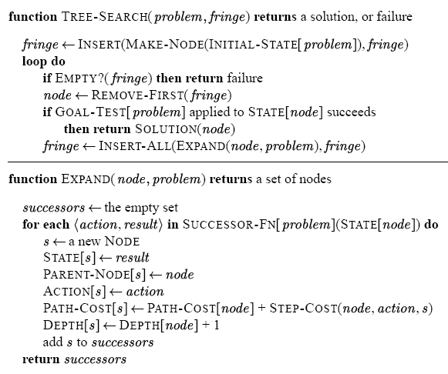
State-Space Search Algorithm
Notes:
Note: Doesn’t check for goal when a node is generated.

Slide 43
Key Issues of State-Space Search Algorithm
Search process constructs a "search tree"
root is the start state
leaf nodes are:
unexpanded nodes (in the Frontier list)
"dead ends" (nodes that aren't goals and have no successors because no operators were applicable)
goal node is last leaf node found
Loops in graph may cause "search tree" to be infinite even if state space is small
Changing the Frontier ordering leads to different search strategies
Notes:
CLICK EACH SUB

Slide 44
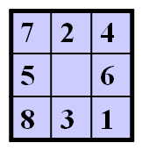
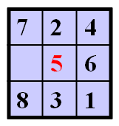
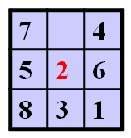
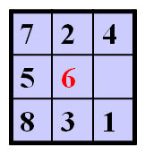
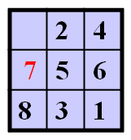
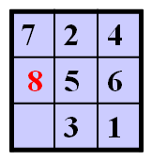
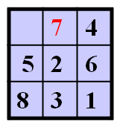
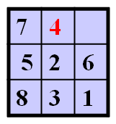
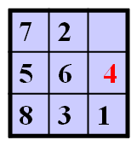
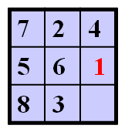
8-Puzzle State-Space Search Tree
(Not all nodes shown; e.g., no “backwards” moves)

Slide 45
Uninformed Search Strategies
Uninformed Search: strategies that order nodes without using any domain specific information, i.e., don’t use any information stored in a state
BFS: breadth-first search
Queue (FIFO) used for the Frontier
remove from front, add to back
DFS: depth-first search
Stack (LIFO) used for the Frontier
remove from front, add to front
Notes:
CLICK EACH SUB

Slide 46
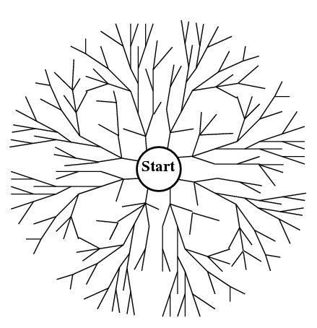
Breadth-First Search (BFS)‏
Expand the shallowest node first:
Examine states one step away from the initial states
Examine states two steps away from the initial states
and so on
Goal

Slide 47
Breadth-First Search (BFS)
generalSearch(problem, queue)
S start
# of nodes tested: 0, expanded: 0
expnd. node | Frontier list
 | {S}
5
2
4
A
B
C
9
4
6
2
D
E
6
G
goal
1
F
7
H
Notes:
CLIKC ANIM: 1. generalSearch, 2. graph, 3. table, 4. # expanded

Slide 48
Breadth-First Search (BFS)
generalSearch(problem, queue)
S start
# of nodes tested: 1, expanded: 1
expnd. node | Frontier list
 | {S}
S not goal | {A,B,C}
5
2
4
A
B
C
9
4
6
2
D
E
6
G
goal
1
F
7
H
Notes:
CLICK ONCE

Slide 49
Breadth-First Search (BFS)
generalSearch(problem, queue)
S start
# of nodes tested: 2, expanded: 2
expnd. node | Frontier list
 | {S}
S | {A,B,C}
A not goal | {B,C,D,E}
5
2
4
A
B
C
9
4
6
2
D
E
6
G
goal
1
F
7
H
Notes:
CLICK ONCE

Slide 50
Breadth-First Search (BFS)
generalSearch(problem, queue)
S start
# of nodes tested: 3, expanded: 3
expnd. node | Frontier list
 | {S}
S | {A,B,C}
A | {B,C,D,E}
B not goal | {C,D,E,G}
5
2
4
A
B
C
9
4
6
2
D
E
6
G
goal
1
F
7
H
Notes:
CLICK ONCE

Slide 51
Breadth-First Search (BFS)
generalSearch(problem, queue)
S start
# of nodes tested: 4, expanded: 4
expnd. node | Frontier list
 | {S}
S | {A,B,C}
A | {B,C,D,E}
B | {C,D,E,G}
C not goal | {D,E,G,F}
5
2
4
A
B
C
9
4
6
2
D
E
6
G
goal
1
F
7
H
Notes:
CLICK ONCE

Slide 52
Breadth-First Search (BFS)
generalSearch(problem, queue)
S start
# of nodes tested: 5, expanded: 5
expnd. node | Frontier list
 | {S}
S | {A,B,C}
A | {B,C,D,E}
B | {C,D,E,G}
C | {D,E,G,F}
D not goal | {E,G,F,H}
5
2
4
A
B
C
9
4
6
2
D
E
6
G
goal
1
F
7
H
Notes:
CLICK ONCE

Slide 53
Breadth-First Search (BFS)
generalSearch(problem, queue)
S start
# of nodes tested: 6, expanded: 6
expnd. node | Frontier list
 | {S}
S | {A,B,C}
A | {B,C,D,E}
B | {C,D,E,G}
C | {D,E,G,F}
D | {E,G,F,H}
E not goal | {G,F,H,G}
5
2
4
A
B
C
9
4
6
2
D
E
6
G
goal
1
F
7
H
Notes:
CLICK ONCE

Slide 54
Breadth-First Search (BFS)
generalSearch(problem, queue)
S start
# of nodes tested: 7, expanded: 6
expnd. node | Frontier list
 | {S}
S | {A,B,C}
A | {B,C,D,E}
B | {C,D,E,G}
C | {D,E,G,F}
D | {E,G,F,H}
E | {G,F,H,G}
G goal | {F,H,G} no expand
5
2
4
A
B
C
9
4
6
2
D
E
6
G
goal
1
F
7
H
Notes:
CLICK ONCE

Slide 55
Breadth-First Search (BFS)
generalSearch(problem, queue)
S start
# of nodes tested: 7, expanded: 6
expnd. node | Frontier list
 | {S}
S | {A,B,C}
A | {B,C,D,E}
B | {C,D,E,G}
C | {D,E,G,F}
D | {E,G,F,H}
E | {G,F,H,G}
G | {F,H,G}
5
2
4
A
B
C
9
4
6
2
D
E
6
G
goal
1
F
7
H
path: S,B,G cost: 8
Notes:
CLICK ONCE

Slide 56
General State-Space Search Algorithm
function general-search(problem, QUEUEING-FUNCTION)‏
;; problem describes the start state, actions, goal test, and
;; action costs
;; queueing-function is a comparator function that ranks two states
;; general-search returns either a goal node or "failure"
frontier = MAKE-QUEUE(MAKE-NODE(problem.INITIAL-STATE))‏
loop
if EMPTY(frontier) then return "failure"
node = REMOVE-FRONT(frontier)‏
if problem.GOAL-TEST(node.STATE) succeeds
then return node
frontier = QUEUEING-FUNCTION(frontier, EXPAND(node,
problem.ACTIONS))‏
;; successors(node) = EXPAND(node, ACTIONS)‏
;; Note: The goal test is NOT done when nodes are generated
;; Note: This algorithm does not detect loops
end

Slide 57
Evaluating Search Strategies
Completeness If a solution exists, will it be found?
a complete algorithm will find a solution (not all)
Optimality / Admissibility If a solution is found, is it guaranteed to be optimal?
an admissible algorithm will find a solution with minimum cost
Notes:
CLICK EACH SUB

Slide 58
Evaluating Search Strategies
Time Complexity How long does it take to find a solution?
usually measured for worst case
measured by counting number of nodes expanded
Space Complexity How much space is used by the algorithm?
measured in terms of the maximum size of the Frontier during the search
Notes:
CLICK EACH SUB

Slide 59
What’s in the Frontier for BFS?
If goal is at depth d, how big is the Frontier (worst case)?
Goal

Slide 60
Breadth-First Search (BFS)
Complete?
Yes
Optimal / Admissible?
Yes, if all operators (i.e., arcs) have the same constant cost, or costs are positive, non-decreasing with depth
otherwise, not optimal but does guarantee finding solution of shortest length (i.e., fewest arcs)
Notes:
CLICK EACH SUB

Slide 61
Breadth-First Search (BFS)
Time and space complexity: O(b^{d}) (i.e., exponential)
d is the depth of the solution
b is the branching factor at each non-leaf node
Very slow to find solutions with a large number of steps because must look at all shorter length possibilities first
Notes:
CLICK EACH SUB

Slide 62
Breadth-First Search (BFS)
A complete search tree has a total # of nodes = 1 + b + b² + ... + b^{d} = (b^{(d+1)} - 1) / (b-1)
d: the tree's depth
b: the branching factor at each non-leaf node
For example: d = 12, b = 10
1 + 10 + 100 + ... + 10¹² = (10¹³ - 1)/9 = O(10¹²)
If BFS expands 1,000 nodes/sec and each node uses 100 bytes of storage, then BFS will take 35 years to run in the worst case, and it will use 111 terabytes of memory!
Notes:
CLICK EACH SUB

Slide 63
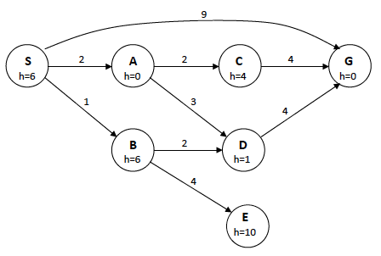
Problem: Given State Space

Slide 64
Assume child nodes visited in increasing alphabetical order
BFS = ?
Notes:
BFS = SABG. Solution path: SG

Slide 65
Breadth-First Search
List sequence of squares “expanded”
Positions are pushed onto queue in clockwise order, so when removed they are “visited” in clockwise order
Assume “cycle checking” done so a node is not added if it occurs on path back to root in search tree

Slide 66
Depth-First Search
Expand the deepest node first
Select a direction, go deep to the end
Slightly change the end
Slightly change the end some more…
Use a Stack to order nodes on the Frontier
Goal

Slide 67
Depth-First Search (DFS)
generalSearch(problem, stack)
S start
# of nodes tested: 0, expanded: 0
expnd. node | Frontier
 | {S}
5
2
4
A
B
C
9
4
6
2
D
E
6
G
goal
1
F
7
H
Notes:
CLICK DESC: 1. interior nodes, 2. leaf nodes, 3. arcs

Slide 68
Depth-First Search (DFS)
generalSearch(problem, stack)
S start
# of nodes tested: 1, expanded: 1
expnd. node | Frontier
 | {S}
S not goal | {A,B,C}
5
2
4
A
B
C
9
4
6
2
D
E
6
G
goal
1
F
7
H
Notes:
CLICK ONCE

Slide 69
Depth-First Search (DFS)
generalSearch(problem, stack)
S start
# of nodes tested: 2, expanded: 2
expnd. node | Frontier
 | {S}
S | {A,B,C}
A not goal | {D,E,B,C}
5
2
4
A
B
C
9
4
6
2
D
E
6
G
goal
1
F
7
H
Notes:
CLICK ONCE

Slide 70
Depth-First Search (DFS)
generalSearch(problem, stack)
S start
# of nodes tested: 3, expanded: 3
expnd. node | Frontier
 | {S}
S | {A,B,C}
A | {D,E,B,C}
D not goal | {H,E,B,C}
5
2
4
A
B
C
9
4
6
2
D
E
6
G
goal
1
F
7
H
Notes:
CLICK ONCE

Slide 71
Depth-First Search (DFS)
generalSearch(problem, stack)
S start
# of nodes tested: 4, expanded: 4
expnd. node | Frontier
 | {S}
S | {A,B,C}
A | {D,E,B,C}
D | {H,E,B,C}
H not goal | {E,B,C}
5
2
4
A
B
C
9
4
6
2
D
E
6
G
goal
1
F
7
H
Notes:
CLICK ONCE

Slide 72
Depth-First Search (DFS)
generalSearch(problem, stack)
S start
# of nodes tested: 5, expanded: 5
expnd. node | Frontier
 | {S}
S | {A,B,C}
A | {D,E,B,C}
D | {H,E,B,C}
H | {E,B,C}
E not goal | {G,B,C}
5
2
4
A
B
C
9
4
6
2
D
E
6
G
goal
1
F
7
H
Notes:
CLICK ONCE

Slide 73
Depth-First Search (DFS)
generalSearch(problem, stack)
S start
# of nodes tested: 6, expanded: 5
expnd. node | Frontier
 | {S}
S | {A,B,C}
A | {D,E,B,C}
D | {H,E,B,C}
H | {E,B,C}
E | {G,B,C}
G goal | {B,C} no expand
5
2
4
A
B
C
9
4
6
2
D
E
6
G
goal
1
F
7
H
Notes:
CLICK ONCE

Slide 74
Depth-First Search (DFS)
generalSearch(problem, stack)
S start
# of nodes tested: 6, expanded: 5
expnd. node | Frontier
 | {S}
S | {A,B,C}
A | {D,E,B,C}
D | {H,E,B,C}
H | {E,B,C}
E | {G,B,C}
G | {B,C}
5
2
4
A
B
C
9
4
6
2
D
E
6
G
goal
1
F
7
H
path: S,A,E,G cost: 15
Notes:
CLICK ONCE

Slide 75
Problem: Given State Space

Slide 76
Assume child nodes visited in increasing alphabetical order
Do Cycle Checking: Don’t add node to Frontier if its state already occurs on path back to root
DFS = ?
Notes:
DFS = SACG. Solution path: SACG

Slide 77
Depth-First Search (DFS)
May not terminate without a depth bound i.e., cutting off search below a fixed depth, D
Not complete
with or without cycle detection
and, with or without a depth cutoff
Not optimal / admissible
Can find long solutions quickly if lucky
Notes:
CLICK EACH SUB
Not complete: even with cycle detection search could get off track, goal: stack 3 red blocks, search explores building a tower of blue blocks, search continues forever without cycles given an infinite supply of blue blocks…

Slide 78
Depth-First Search (DFS)
Time complexity: O(b^{d}) exponential Space complexity: O(bd) linear
d is the depth of the solution
b is the branching factor at each non-leaf node
Performs “chronological backtracking”
i.e., when search hits a dead end, backs up one level at a time
problematic if the mistake occurs because of a bad action choice near the top of search tree
Notes:
CLICK EACH SUB

Slide 79
Uniform-Cost Search (UCS)
Use a “Priority Queue” to order nodes on the Frontier list, sorted by path cost
Let g(n) = cost of path from start node s to current node n
Sort nodes by increasing value of g
Notes:
CLICK EACH SUB

Slide 80
Uniform-Cost Search (UCS)
generalSearch(problem, priorityQueue)
S start
# of nodes tested: 0, expanded: 0
expnd. node | Frontier list
 | {S}
5
2
4
A
B
C
9
4
6
2
D
E
6
G
goal
1
F
7
H
Notes:
CLICK DESC: 1. interior nodes, 2. leaf nodes, 3. arcs

Slide 81
Uniform-Cost Search (UCS)
generalSearch(problem, priorityQueue)
S start
# of nodes tested: 1, expanded: 1
expnd. node | Frontier list
 | {S:0}
S not goal | {B:2,C:4,A:5}
5
2
4
A
B
C
9
4
6
2
D
E
6
G
goal
1
F
7
H
Notes:
CLICK ONCE

Slide 82
Uniform-Cost Search (UCS)
generalSearch(problem, priorityQueue)
S start
# of nodes tested: 2, expanded: 2
expnd. node | Frontier list
 | {S}
S | {B:2,C:4,A:5}
B not goal | {C:4,A:5,G:2+6}
5
2
4
A
B
C
9
4
6
2
D
E
6
G
goal
1
F
7
H
Notes:
CLICK ONCE

Slide 83
Uniform-Cost Search (UCS)
generalSearch(problem, priorityQueue)
S start
# of nodes tested: 3, expanded: 3
expnd. node | Frontier list
 | {S}
S | {B:2,C:4,A:5}
B | {C:4,A:5,G:8}
C not goal | {A:5,F:4+2,G:8}
5
2
4
A
B
C
9
4
6
2
D
E
6
G
goal
1
F
7
H
Notes:
CLICK ONCE

Slide 84
Uniform-Cost Search (UCS)
generalSearch(problem, priorityQueue)
S start
# of nodes tested: 4, expanded: 4
expnd. node | Frontier list
 | {S}
S | {B:2,C:4,A:5}
B | {C:4,A:5,G:8}
C | {A:5,F:6,G:8}
A not goal | {F:6,G:8,E:5+4, D:5+9}
5
2
4
A
B
C
9
4
6
2
D
E
6
G
goal
1
F
7
H
Notes:
CLICK ONCE

Slide 85
Uniform-Cost Search (UCS)
generalSearch(problem, priorityQueue)
S start
# of nodes tested: 5, expanded: 5
expnd. node | Frontier list
 | {S}
S | {B:2,C:4,A:5}
B | {C:4,A:5,G:8}
C | {A:5,F:6,G:8}
A | {F:6,G:8,E:9,D:14}
F not goal | {G:4+2+1,G:8,E:9,D:14}
5
2
4
A
B
C
9
4
6
2
D
E
6
G
goal
1
F
7
H
Notes:
CLICK ONCE

Slide 86
Uniform-Cost Search (UCS)
generalSearch(problem, priorityQueue)
S start
# of nodes tested: 6, expanded: 5
expnd. node | Frontier list
 | {S}
S | {B:2,C:4,A:5}
B | {C:4,A:5,G:8}
C | {A:5,F:6,G:8}
A | {F:6,G:8,E:9,D:14}
F | {G:7,G:8,E:9,D:14}
G goal | {G:8,E:9,D:14} no expand
5
2
4
A
B
C
9
4
6
2
D
E
6
G
goal
1
F
7
H
Notes:
CLICK ONCE

Slide 87
Uniform-Cost Search (UCS)
generalSearch(problem, priorityQueue)
S start
# of nodes tested: 6, expanded: 5
expnd. node | Frontier list
 | {S}
S | {B:2,C:4,A:5}
B | {C:4,A:5,G:8}
C | {A:5,F:6,G:8}
A | {F:6,G:8,E:9,D:14}
F | {G:7,G:8,E:9,D:14}
G | {G:8,E:9,D:14}
5
2
4
A
B
C
9
4
6
2
D
E
6
G
goal
1
F
7
H
path: S,C,F,G cost: 7
Notes:
CLICK ONCE

Slide 88
Problem: Given State Space

Slide 89
Assume child nodes visited in increasing alphabetical order
UCS = ?
Notes:
UCS: SBADCEG. Solution path: SBDG

Slide 90
Uniform-Cost Search (UCS)
Called Dijkstra's Algorithm in the algorithms literature
Similar to Branch and Bound Algorithm in Operations Research literature
Complete
Optimal / Admissible
requires that the goal test is done when a node is removed from the Frontier rather than when the node is generated by its parent node
Notes:
not optimal if goal test done when nodes added to nodes list
S
4 5
A B
7 3
G
UCS (normal) finds SBG cost 8
UCS(modified) finds SAG cost 11 NOT OPTIMAL!

Slide 91
Uniform-Cost Search (UCS)
Time and space complexity: O(b^{d}) (i.e., exponential)
d is the depth of the solution
b is the branching factor at each non-leaf node
More precisely, time and space complexity is O(b^{C*/ε} ) where all edge costs are ε, ε > 0, and C* is the best goal path cost
Notes:
CLICK EACH SUB

Slide 92
Iterative-Deepening Search (IDS)
requires modification to DFS search algorithm:
do DFS to depth 1 and treat all children of the start node as leaves
if no solution found, do DFS to depth 2
repeat by increasing “depth bound” until a solution found
Start node is at depth 0
Notes:
CLICK EACH SUB

Slide 93
Iterative-Deepening Search (IDS)
deepeningSearch(problem)
S start
depth: 1, # of nodes expanded: 0, tested: 0
expnd. node | Frontier
 | {S}
5
2
4
A
B
C
9
4
6
2
D
E
6
G
goal
1
F
7
H
Notes:
CLICK DESC: 1. interior nodes, 2. leaf nodes, 3. arcs

Slide 94
Iterative-Deepening Search (IDS)
deepeningSearch(problem)
S start
depth: 1, # of nodes tested: 1, expanded: 1
expnd. node | Frontier
 | {S}
S not goal | {A,B,C}
5
2
4
A
B
C
9
4
6
2
D
E
6
G
goal
1
F
7
H
Notes:
CLICK ONCE

Slide 95
Iterative-Deepening Search (IDS)
deepeningSearch(problem)
S start
depth: 1, # of nodes tested: 2, expanded: 1
expnd. node | Frontier
 | {S}
S | {A,B,C}
A not goal | {B,C} no expand
5
2
4
A
B
C
9
4
6
2
D
E
6
G
goal
1
F
7
H
Notes:
CLICK ONCE

Slide 96
Iterative-Deepening Search (IDS)
deepeningSearch(problem)
S start
depth: 1, # of nodes tested: 3, expanded: 1
expnd. node | Frontier
 | {S}
S | {A,B,C}
A | {B,C}
B not goal | {C} no expand
5
2
4
A
B
C
9
4
6
2
D
E
6
G
goal
1
F
7
H
Notes:
CLICK ONCE

Slide 97
Iterative-Deepening Search (IDS)
deepeningSearch(problem)
S start
depth: 1, # of nodes tested: 4, expanded: 1
expnd. node | Frontier
 | {S}
S | {A,B,C}
A | {B,C}
B | {C}
C not goal | { } no expand-FAIL
5
2
4
A
B
C
9
4
6
2
D
E
6
G
goal
1
F
7
H
Notes:
CLICK ONCE

Slide 98
Iterative-Deepening Search (IDS)
deepeningSearch(problem)
S start
depth: 2, # of nodes tested: 4(1), expanded: 2
expnd. node | Frontier
 | {S}
S | {A,B,C}
A | {B,C}
B | {C}
C | { }
S no test | {A,B,C}
5
2
4
A
B
C
9
4
6
2
D
E
6
G
goal
1
F
7
H
Notes:
CLICK ONCE

Slide 99
Iterative-Deepening Search (IDS)
deepeningSearch(problem)
S start
depth: 2, # of nodes tested: 4(2), expanded: 3
expnd. node | Frontier
 | {S}
S | {A,B,C}
A | {B,C}
B | {C}
C | { }
S | {A,B,C}
A no test | {D,E,B,C}
5
2
4
A
B
C
9
4
6
2
D
E
6
G
goal
1
F
7
H
Notes:
CLICK ONCE

Slide 100
Iterative-Deepening Search (IDS)
deepeningSearch(problem)
S start
depth: 2, # of nodes tested: 5(2), expanded: 3
expnd. node | Frontier
 | {S}
S | {A,B,C}
A | {B,C}
B | {C}
C | { }
S | {A,B,C}
A | {D,E,B,C}
D not goal | {E,B,C} no expand
5
2
4
A
B
C
9
4
6
2
D
E
6
G
goal
1
F
7
H
Notes:
CLICK ONCE

Slide 101
Iterative-Deepening Search (IDS)
deepeningSearch(problem)
S start
depth: 2, # of nodes tested: 6(2), expanded: 3
expnd. node | Frontier
 | {S}
S | {A,B,C}
A | {B,C}
B | {C}
C | { }
S | {A,B,C}
A | {D,E,B,C}
D | {E,B,C}
E not goal | {B,C} no expand
5
2
4
A
B
C
9
4
6
2
D
E
6
G
goal
1
F
7
H
Notes:
CLICK ONCE

Slide 102
Iterative-Deepening Search (IDS)
deepeningSearch(problem)
S start
depth: 2, # of nodes tested: 6(3), expanded: 4
expnd. node | Frontier
 | {S}
S | {A,B,C}
A | {B,C}
B | {C}
C | { }
S | {A,B,C}
A | {D,E,B,C}
D | {E,B,C}
E | {B,C}
B no test | {G,C}
5
2
4
A
B
C
9
4
6
2
D
E
6
G
goal
1
F
7
H
Notes:
CLICK ONCE

Slide 103
Iterative-Deepening Search (IDS)
deepeningSearch(problem)
S start
depth: 2, # of nodes tested: 7(3), expanded: 4
expnd. node | Frontier
 | {S}
S | {A,B,C}
A | {B,C}
B | {C}
C | { }
S | {A,B,C}
A | {D,E,B,C}
D | {E,B,C}
E | {B,C}
B | {G,C}
G goal | {C} no expand
5
2
4
A
B
C
9
4
6
2
D
E
6
G
goal
1
F
7
H
Notes:
CLICK ONCE

Slide 104
Iterative-Deepening Search (IDS)
deepeningSearch(problem)
S start
depth: 2, # of nodes tested: 7(3), expanded: 4
expnd. node | Frontier
 | {S}
S | {A,B,C}
A | {B,C}
B | {C}
C | { }
S | {A,B,C}
A | {D,E,B,C}
D | {E,B,C}
E | {B,C}
B | {G,C}
G | {C}
5
2
4
A
B
C
9
4
6
2
D
E
6
G
goal
1
F
7
H
path: S,B,G cost: 8
Notes:
CLICK ONCE

Slide 105
Iterative-Deepening Search (IDS)
Has advantages of BFS
completeness
optimality as stated for BFS
Has advantages of DFS
limited space
in practice, even with redundant effort it still finds longer paths more quickly than BFS
Notes:
CLICK EACH SUB

Slide 106
Iterative-Deepening Search (IDS)
Space complexity: O(bd) (i.e., linear like DFS)
Time complexity is a little worse than BFS or DFS
because nodes near the top of the search tree are generated multiple times (redundant effort)
Worst case time complexity: O(b^{d}) exponential
because most nodes are near the bottom of tree
Notes:
CLICK EACH SUB

Slide 107
Iterative-Deepening Search (IDS)
How much redundant effort is done?
The number of times the nodes are generated: 1b^{d} + 2b^{(d-1)} + ... + db ≤ b^{d} / (1 – 1/b)² = O(b^{d})
d: the solution's depth
b: the branching factor at each non-leaf node
For example: b = 4
4^{d} / (1 – ¼)² = 4^{d} / (.75)² = 1.78 × 4^{d}
in the worst case, 78% more nodes are searched (redundant effort) than exist at depth d
as b increases, this % decreases
Notes:
CLICK EACH SUB

Slide 108
Iterative-Deepening Search
Trades a little time for a huge reduction in space
lets you do breadth-first search with (more space efficient) depth-first search
“Anytime” algorithm: good for response-time critical applications, e.g., games
An “anytime” algorithm is an algorithm that can return a valid solution to a problem even if it's interrupted at any time before it ends. The algorithm is expected to find better and better solutions the longer it runs.

Slide 109
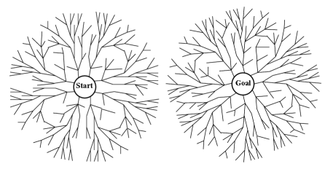
Bidirectional Search
Breadth-first search from both start and goal
Stop when Frontiers meet
Generates O(b^{d/2}) instead of O(b^{d}) nodes
start
goal

Slide 110
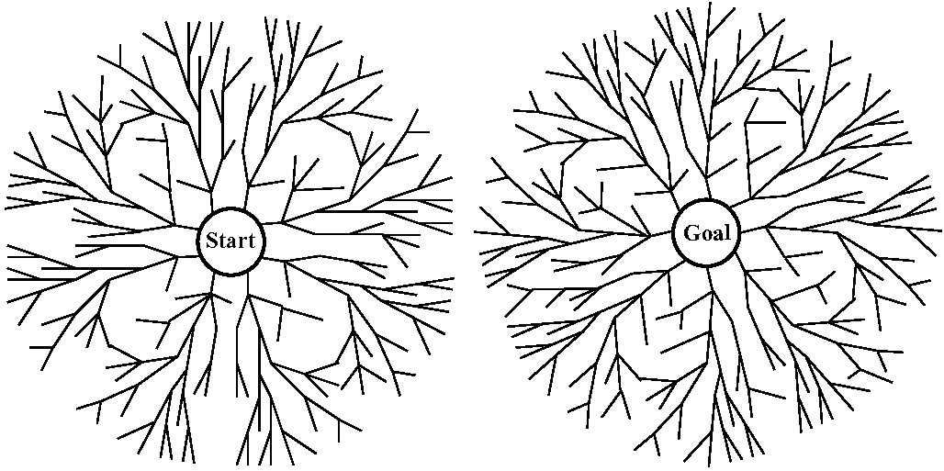
Which Direction Should We Search?
Our choices: Forward, backwards, or bidirectional
The issues: How many start and goal states are there?
Branching factors in each direction
How much work is it to compare states?

Slide 111
Performance of Search Algorithms on Trees
b: branching factor (assume finite) d: goal depth m: graph depth
Complete
optimal
time
space
Breadth-first search
Y
Y, if ¹
O(b^{d})‏
O(b^{d})‏
Uniform-cost search²
Y
Y
O(b^{C*/ε})
O(b^{C*/ε})‏
Depth-first search
N
N
O(b^{m})
O(bm)
Iterative deepening
Y
Y, if ¹
O(b^{d})‏
O(bd)‏
Bidirectional search³
Y
Y, if ¹
O(b^{d/2})‏
O(b^{d/2})‏
edge cost constant, or positive non-decreasing in depth
edge costs ε, ε > 0. C* is the best goal path cost
both directions BFS; not always feasible

Slide 112
If State Space is Not a Tree
The problem: repeated states
Ignoring repeated states: wasteful (BFS) or impossible (DFS). Why?
How to prevent these problems?
D, CFS
DFS, C
CSDF,
CD,SF
CDF, S
S, CFD
SF, CD
, CSDF
C, DSF
CSF, D

Slide 113
If State Space is Not a Tree
We have to remember already-expanded states (called Explored (aka Closed) set) too
When we pick a node from Frontier
Remove it from Frontier
Add it to Explored
Expand node, generating all successors
For each successor, child,
If child is in Explored or in Frontier, throw child away // for BFS and DFS
Otherwise, add it to Frontier
Called Graph-Search algorithm in Figure 3.7 and Uniform-Cost-Search in Figure 3.14

Slide 114
function Uniform-Cost-Search (problem)
loop do
if Empty?(frontier) then return failure
node = Pop(frontier)
if Goal?(node) then return Solution(node)
Insert node in explored
foreach child of node do
if child not in frontier or explored then
Insert child in frontier
else if child in frontier with higher cost then
Remove that old node from frontier
Insert child in frontier
This is the algorithm in Figure 3.14 in the textbook; note that if child is not in frontier but is in explored, this algorithm will throw away child

Slide 115
If State Space is Not a Tree
BFS:
Still O(b^{d}) space complexity, not worse
DFS:
Known as Memorizing DFS (MEMDFS)‏
Space and time now O(min(N, b^{M})) – much worse!
N: number of states in problem
M: length of longest cycle-free path from start to anywhere
Alternative: Path-Check DFS (PCDFS): remember only expanded states on current path (from start to the current node)
Space O(M)
Time O(b^{M})

Slide 116
Example
S
1 5 8
A
B
C
3 7 9 4 5
How are nodes expanded by
Depth First Search
Breadth First Search
Uniform Cost Search
Iterative Deepening
Are the solutions the same?
D
E
G

Slide 117
Nodes Expanded by:
Depth-First Search: S A D E G
Solution found: S A G
Breadth-First Search: S A B C D E G
Solution found: S A G
Uniform-Cost Search: S A D B C E G
Solution found: S B G
Iterative-Deepening Search: S A B C S A D E G
Solution found: S A G

Slide 118
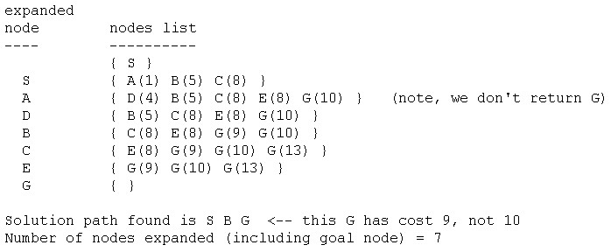
Uniform-Cost Search

Slide 119
General Search with Open and Closed
//Note: this algorithm does detect loops in the state space
Node generalSearch (Problem problem, List OPEN) {
OPEN.add(new Node(problem.getStartState()));
List CLOSED = new List(); //initially empty, just a List DS
while (true) {
if (OPEN.isEmpty()) return new Node("failure");
Node node = OPEN.remove(); //removes front node
if (problem.isGoal(node.getState())) return node;
CLOSED.add(node); //remember it was expanded
OPEN.add(expand node given problem operators);
//expand: only add successors not already in OPEN or CLOSED
}
}
Notes:
CLICK EACH SUB

